Slide 1
Finance Club

Slide 2
Topics to be Covered
Corporate Finance
Personal Finance
Investing
Financial Economics
Accounting
Banking and Financial services
Taxation and Insurance
Stock Market and Trading

Slide 3
Session 1
23 - 12 - 2022 (Day 4)

Slide 4
Warmer
I am the fundamental worth contained in an asset. Who am I?
I _ _ _ i _ _ i _ _ a _ u e
I n t r i n s i c V a l u e
Notes:
Intrinsic Value
https://www.investopedia.com/articles/basics/12/intrinsic-value.asp

Slide 5
Academic qualification are important but so is financial education. The’re both important and schools are forgetting one of them.
Robert Kiyosaki

Slide 6
Finance
Finance is a term broadly describing the study and system of money, investments, and other financial instruments.
Finance can be divided broadly into three distinct categories: public finance, corporate finance, and personal finance.
How is it different from Economics?
Notes:
https://www.investopedia.com/terms/f/finance.asp

Slide 7
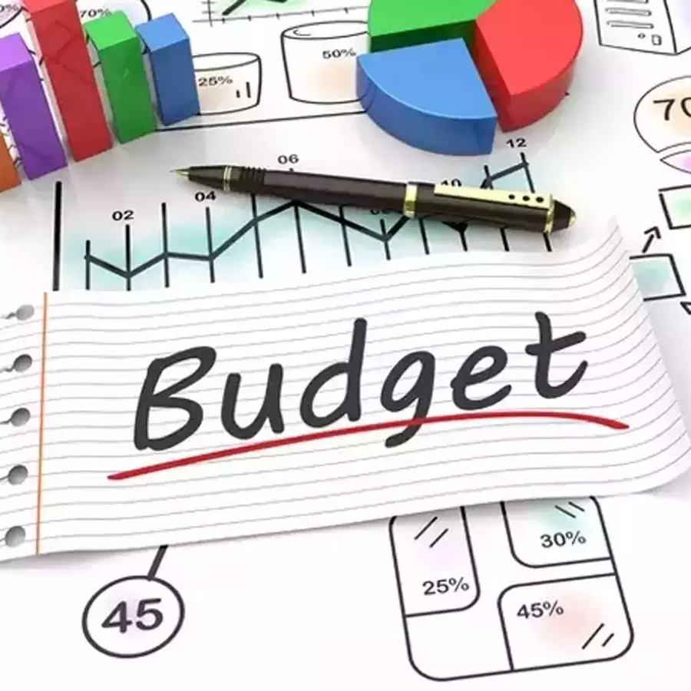
Types of Finance
Public Finance
Corporate Finance
Personal Finance
Notes:
https://www.investopedia.com/terms/f/finance.asp
https://s3.amazonaws.com/utep-uploads/wp-content/uploads/sparkle-box/2019/04/30112128/corporate-meeting-with-finance-director.jpg
https://img.etimg.com/thumb/msid-67450028,width-1200,height-900,imgsize-405947,overlay-economictimes/photo.jpg
https://www.acecloudhosting.com/blog/wp-content/uploads/2019/06/money-saving-budget-tips.jpg

Slide 8
Session 2
27 - 07 - 2022 (Day 4)

Slide 9
Warmer
Planning how to divide one’s own money towards needs, wants and savings.
_ _ _ a _ e _ i _ _ _ _ o _ a _ i o _
S t r a t e g i c A l l o c a t i o n
Notes:
Strategic Allocation

Slide 10
Budgeting and Saving

Slide 11
“Beware of little expenses, small leak will sink a great ship”
Benjamin Franklin

Slide 12
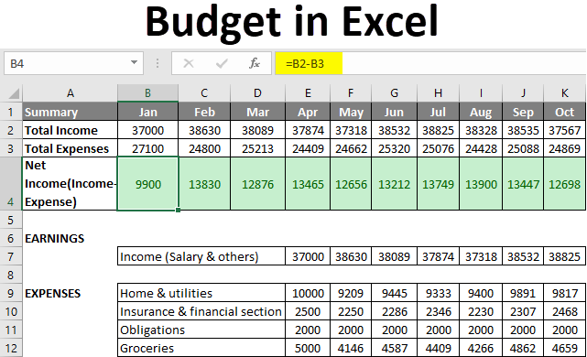
Budgeting Basics
Budgeting is a proactive approach to organizing your finances.
This includes income, expenses and savings.
Income - Saving = Expenses
There are 3 categories where income can be allocated
Need
Want
Savings
Notes:
https://cdn.educba.com/academy/wp-content/uploads/2019/06/Budget-in-Excel.png

Slide 13
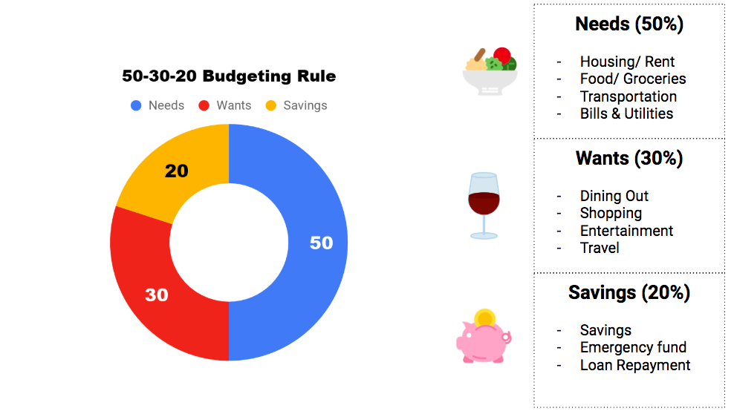

Slide 14
Investing

Slide 15
Investing
Investing Basics
Basics of Stock Market
Fundamental analysis
Technical Analysis
Stock Investing Strategies
Futures and Options
Mutual Funds, SIP and SWP
Bonds, EPF and PPF
Gold, Commodities
Real Estate
Cryptocurrency and NFTs

Slide 16
Investing Basics
Why should one Invest
Who should invest
How can you invest in India
What options does one have
Common FAQs
Is Investing risky?
Do we need a lot of money to start?
Can I invest without having proficient knowledge?

Slide 17
General Terminologies
Compounding
CAGR
Shares
Market price
Debt
Equity
Asset

Slide 18
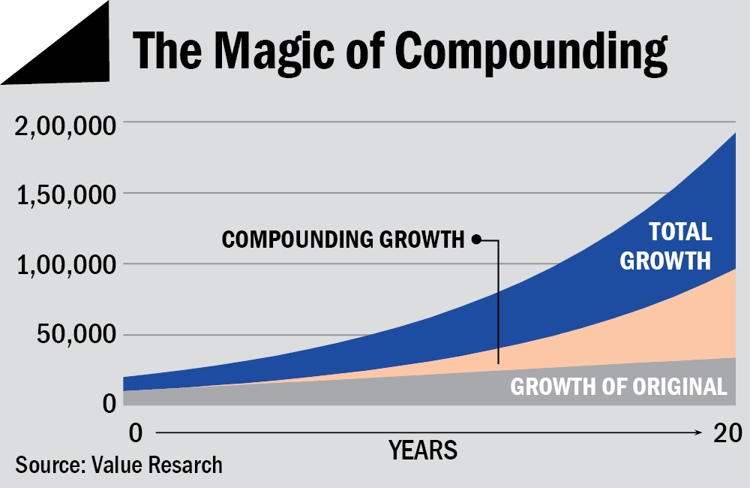
Compounding
How to become crorepati in 15 years
Step 1 : Invest _ per month
Step 2 : Achieve 15% CAGR
Step 3 : Wait for 15 years
Voila! Now you are a crorepati
Rs. 15000/-

Slide 19
Let’s Explore how compounding works using a google sheet

Slide 20
Basics of Stock Market

Slide 21
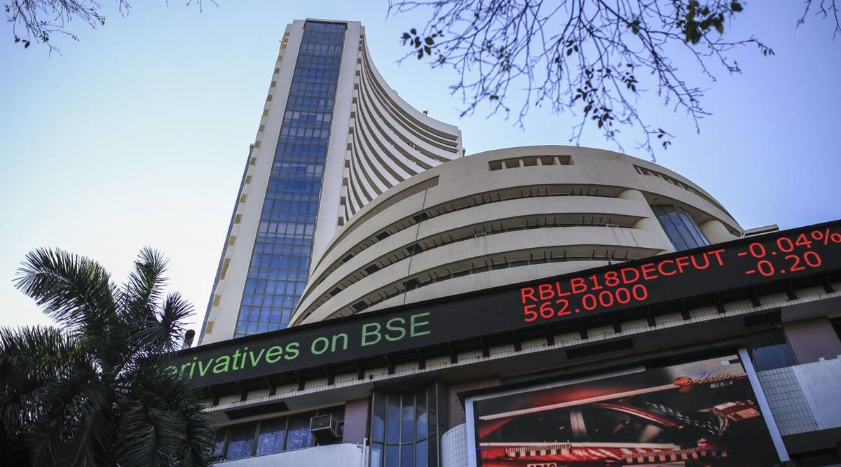
What is Stock Market?
Stock Market is where buyers and sellers meet
Exchange of shares of a company happens when a seller sells and a buyer buys them
Stock trading by retail investors is done online through a demat account like Zerodha, Angel One etc. linked to your bank account.

Slide 22
What is a Stock Exchange?
Stock Exchange is the marketplace where different financial instruments such as stocks, ETFs, commodities, bonds etc. are traded on the Stock Exchange.
Examples include, NSE, BSE, NYSE

Slide 23
Advantages of Stock Exchange
Stock Exchange allows domestic companies to acquire investments from foreign investors.
Stock Exchange helps the companies acquire capital without debt, helping them expand and grow. (IPO - Initial Public Offering, and FPO - Follow on Public Offer)
They are highly regulated
It provides an opportunity to the common public to invest in the companies listed on the stock exchange, and become owner of a small part of the company
Notes:
Stock Exchange allows domestic companies to acquire funding from foreign companies, ensuring flow of money in the economy.
Stock Exchange helps the companies acquire capital without leverage, helping them expand and grow.
They are highly regulated (so the unfair practices followed by the people and the companies are acted upon easily and immediately)
It provides an opportunity to the common public to invest in the companies listed on the stock exchange, and become owner of a small part of the company, so they can earn money from the appreciation of the stock price, and potentially earn a higher interest rate than the Bank FDs.

Slide 24
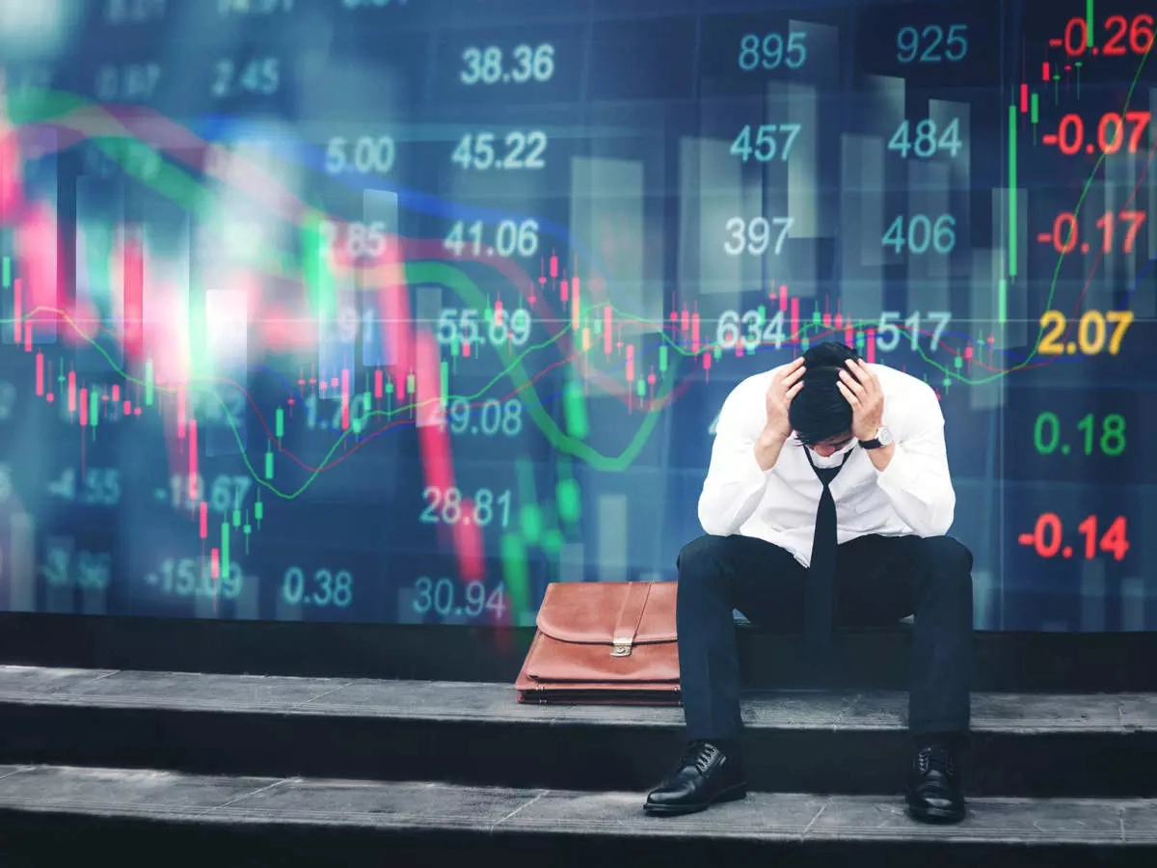
Disadvantages of Stock Exchange
They are highly regulated
There are chances of scams taking place in the Stock Markets. Major scams can even lead to recessions.
Stock Market can be manipulated by big players
Retail Investors do not get completely transparent information
Notes:
They are highly regulated (for example, during the Russia-Ukraine crisis, the Russian stock exchange were closed for trading for approximately a month)
There are chances of scams taking place in the Stock Markets, and Scams can worsen the sentiments of the people in the country, causing protests. Major scams can even lead to recessions. (however the chances of scams are low)

Slide 25
Role of Stock Exchange in the Economy
Stock Exchange helps companies offer their equity to the public in exchange for raising funds and capital for expanding.
It helps ensure foreign investment (through FIIs - Foreign Institutional Investors) in the domestic companies.
They ensure that the money saved by the people is not kept idle, rather is invested somewhere, and is flowing in the economy.
The stock prices influence a companies decision on Merger and Acquisitions, shares issuance, market value etc.

Slide 26
Current trends in the Stock Market?
Can you name some macroeconomic factors that affect the stock market?
Interest rates, Inflation, GDP data, Unemployment rate, Exchange rates etc.
Stock Markets had corrected by around 15% a while ago, but recently there have been signs of improvement in the situation with the indices rebounding a little higher from their lows.
Notes:
(Sanctions on Russia because of its invasion in Ukraine has caused high inflation, leading to interest rate hikes increasing the fear of recession. Also the recent lockdowns in China had caused a decrease in the supply)

Slide 27
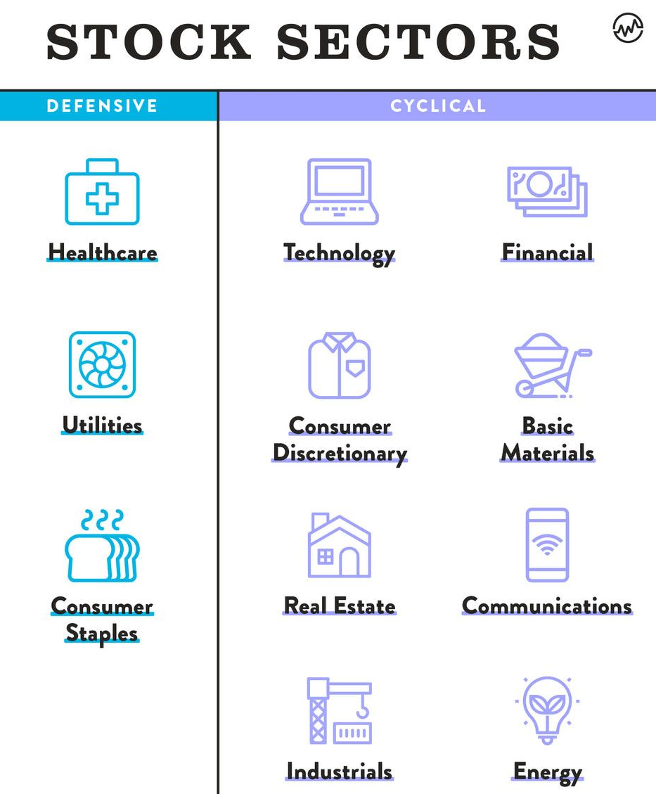
As classified by the GICS*
Notes:
There are 11 stock market sectors, as classified by the Global Industry Classification Standard, which include healthcare, materials, real estate, consumer staples, consumer discretionary, utilities, energy, industrials, consumer services, financials, and technology.

Slide 28
Activity Time
Amount = 1 lakh INR
Task: Divide the amount in these four stocks given below, and provide the reason behind it.
Stock Name | CMP
Reliance Industries | 2642
Tata Power | 236.5
Vodafone Idea | 9
Bank of Baroda | 131

Slide 29
Interesting Facts about the Stock Exchanges
BSE is the oldest stock exchange in India, it was established in 1875.
World’s oldest stock exchange was established in 1602, called the Amsterdam Stock Exchange.
Largest stock exchange in the world by market capitalization is the NYSE, ～$25 trillion.
The Case of Vancouver Stock Exchange
In January 1982 the index was initialized at 1000 and subsequently updated and truncated to 3 decimal places on each trade. Within months it was crushed by ～50%.
It was closed due to this coding error, however, its original value was found to be ～10% higher than its initial value.
https://www.youtube.com/watch?v=RdDIANVl7dc&ab_channel=TopQuark

Slide 30
Session 10
12 - 09 - 2022 (Day 4)

Slide 31
How the stock market works?
The stock prices go up if people are willing to pay higher prices for stocks. This means that the demand for the stock of that company is high by investors and traders.
The opposite happens when the stock price goes down, more people are selling the stock in comparison to the people buying it.
When the supply > demand, the algorithm of stock markets decreases the price and vice versa.
This is reflected in the market price and can be valuable to investors and traders.

Slide 32
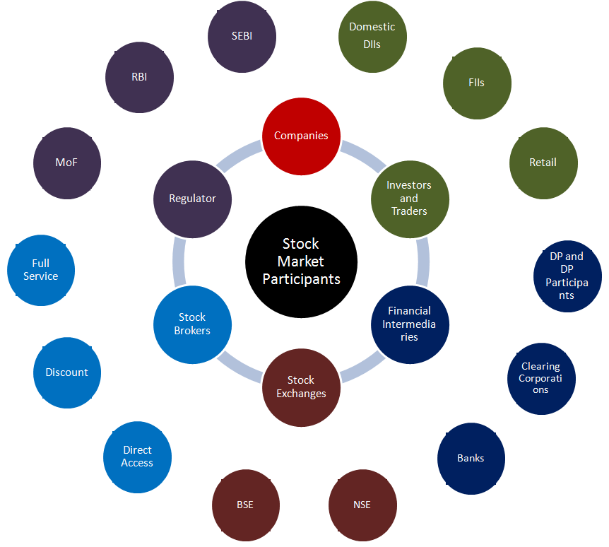
Stakeholders involved in the process of executing a trade
The major ones to discuss :
Regulator
Companies
Exchange
Investors and Traders
Financial intermediaries
Stock brokers

Slide 33
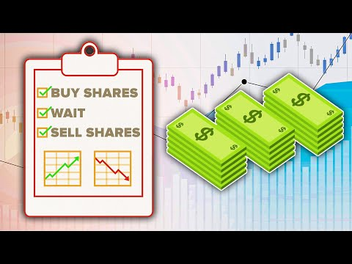
Stock market video

Slide 34
Zee and Sony have done a Merger which is a method of external growth
Option A : People will sell the stock
Option B : People will buy
Option C : People will hold

Slide 35
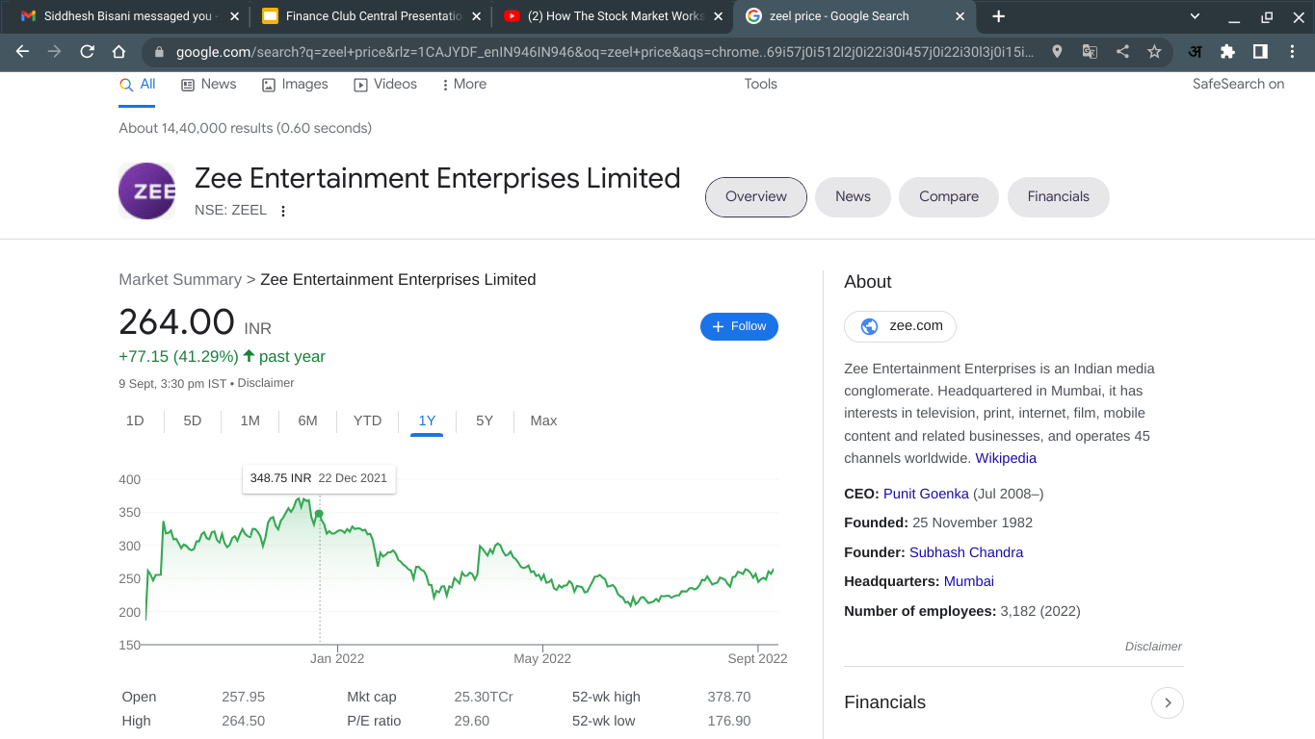

Slide 36
GNFC has reported an increase of 107% in profit from last quarter (March 2022)
Option A : People will sell the stock
Option B : People will buy
Option C : People will hold

Slide 37
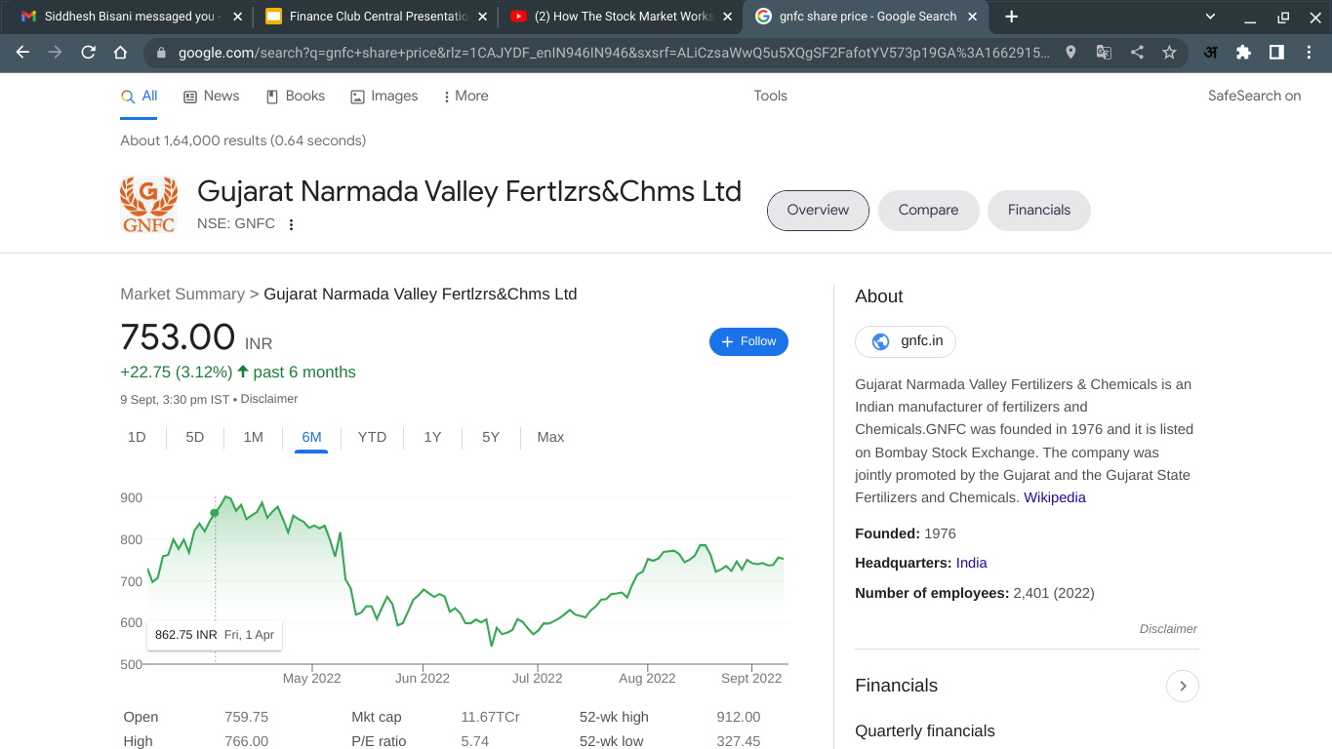

Slide 38
This is trading on news, though we can infer if a news is good for the company or not, without doing a proper analysis and having a rationale, we should not act.

Slide 39
Why people generally lose money in stock market?
Lack of sufficient analysis
Incorrect analysis or prediction of the future prospects of a business
Don’t understand economic trends
Lack of patience
Trading on news and tips
Fear/Panic
Greed
Not keeping risk management

Slide 40
“A cynic knows the price of everything but the value of nothing”
Oscar Wilde

Slide 41
Session 14
27 - 09 - 2022 (Day 2)

Slide 42
Fundamental Analysis

Slide 43
Activity
Pick any company of your choice and do SWOT analysis of it.

Slide 44
Fundamental Analysis
Fundamental analysis is a method of measuring a security's intrinsic value by examining related economic and financial factors. Fundamental analysts study anything that can affect the security's value, from macroeconomic factors such as the state of the economy and industry conditions to microeconomic factors like the effectiveness of the company's management.
Quantitative – "related to information that can be shown in numbers and amounts."
Qualitative – "relating to the nature or standard of something, rather than to its quantity."

Slide 45
Industry Analysis

Slide 46
An Industry or business can be analyzed using Porter's 5 Forces Model.
Competition in the Industry (As soon as Jio entered the telecom sector, a price war started and others' profits started declining. Low competition can bring pricing power in favor of the companies.)
The threat of new entrant (In an industry like Airlines, huge capital cost is required to enter into the industry. Also people like to travel through airlines which already are well established as they find them safer, thus, entries of new players is difficult.)
Threat of substitutes (A company can face elastic demand from other close substitutes also like in Europe, airlines is compared with high speed trains to travel within Europe, Coffee and Tea are also close substitutes to a major extent.)
Bargaining power of suppliers (Intel is the biggest player for manufacturing processors, hence, Dell, HP, etc. can't negotiate much on pricing.)
Bargaining power of customers (Indian railways is a monopoly in their industry and the customers don't have much bargaining power.)

Slide 47
Economic MOAT

